Slide 1
WELCOME
GOALIFY
TRACK IT CRACK IT

Slide 2

AI INTEGRATED SCHEDUALE MAKER
TEAM: TriTech
Members: Gunay Gadimova | Ali Taghizade | Murad Hasanov
Functional Prototype ✓
Articulate Clear Benefits ✓
Opendata portal N/A
Github push ✓
Cloud Run/Vercel/Github pages
Leverage Sponsor Platforms N/A

Slide 3

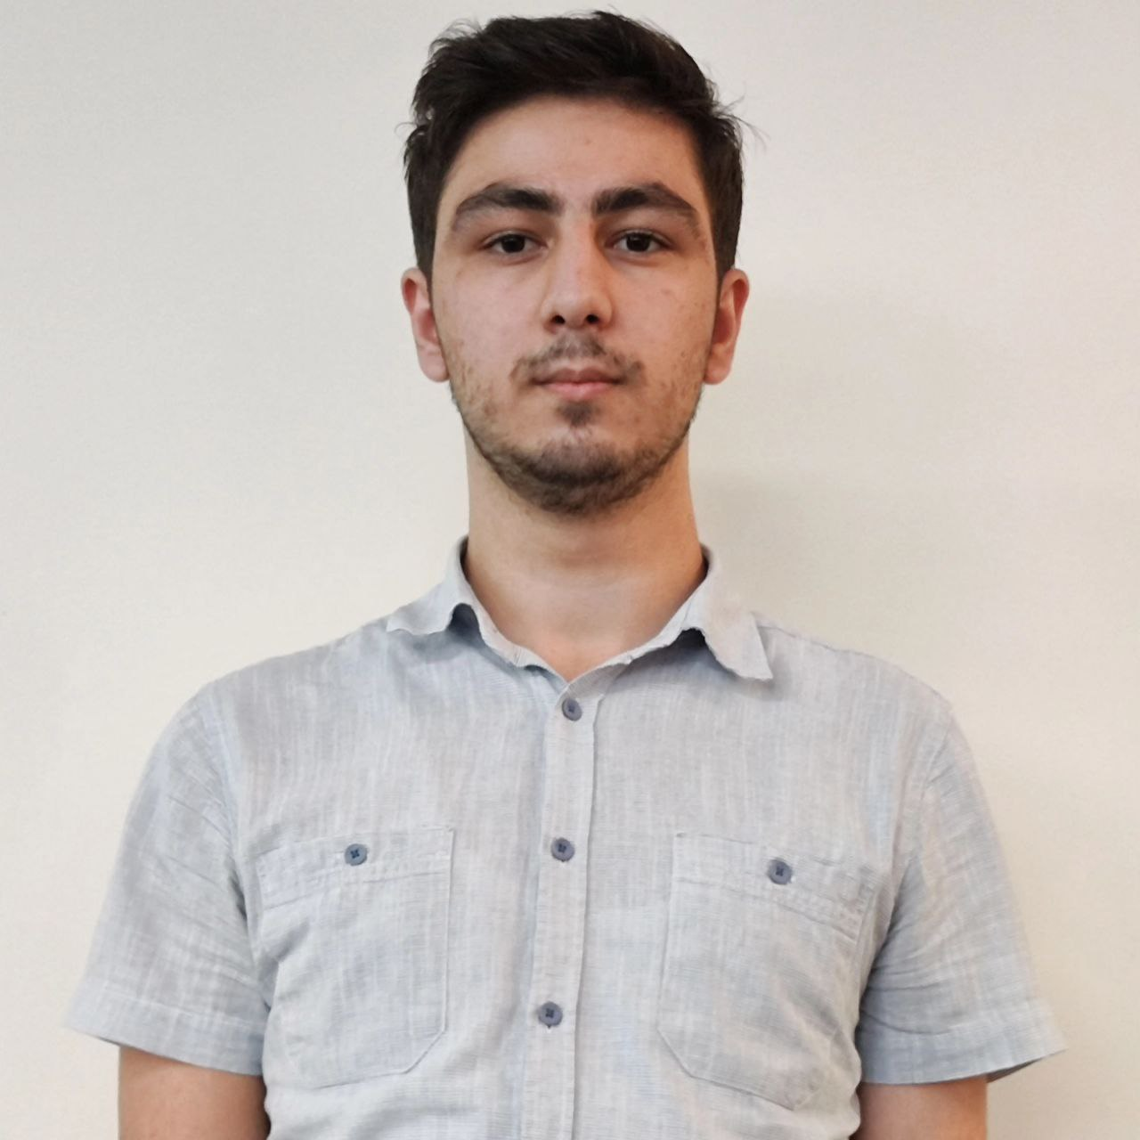

TriTech
Full-Stack DevOps UI/UX Designer ASOIU
AI Engineer Backend DevOps ADA
System Design CTO ASOIU

Slide 4
Problems
1. Ineffective Time Management Poor prioritization causes delays and time loss. Estimated impact: 50% → ~2,510,000 people
2. Task Overlap and Confusion Work, personal life, and activities collide, making plans unmanageable. Estimated impact: 40% → ~2,008,000 people 3. Stress and Psychological Pressure Delays and lack of time increase tension and mental load. Estimated impact: 60% → ~3,012,000 people 4. Decline in Productivity Lack of planning reduces work quality and performance. Estimated impact: 45% → ~2,259,000 people

Slide 5
Solutions to the Problems
1. Ineffective Time Management Schedule Maker helps users set priorities and organize tasks effectively, reducing time loss and ensuring daily order.
2. Task Overlap and Confusion The platform unifies all activities in one schedule. The auto-planning feature prevents tasks from overlapping.
3. Stress and Psychological Pressure Balanced time allocation and reminders create a sense of control, reducing daily stress.
4. Decline in Productivity Following plans and completing tasks on time improves overall productivity and work quality.

Slide 6
Business Model
1. Free Package (Basic Version)
Free access for users
Limited AI support (30 tokens)
Access to core planning features
2. Plus Package Monthly subscription: 5 AZN
Unlimited planning and extended AI,
Extra features: statistical analysis, advanced reminders
3. B2B Package (For Companies)
Partnership-based for businesses and teams
Corporate planning with custom AI solutions
Team-based scheduling options

Slide 7
Core Magic Power – “Magic Touch”
Users just describe their day, AI instantly creates a full schedule
Custom AI reduces costs and removes the need for extra tools
Enables fully personalized planning models for each company
Future-proof system adapts quickly to market changes and stays updated
Result: An adaptive, flexible, and long-term planning solution for both individuals and businesses

Slide 8
Marketing & Sales
Target Audience
Students & individuals (simple and accessible planning)
Freelancers & professionals (efficient work management)
Teams & companies (adaptive B2B planning)
Value Proposition
With just a 5 AZN Plus package, anyone can build AI-powered schedules
B2B models help companies cut costs and enable flexible management
Technological Advantage
Custom LLM enables fully personalized planning solutions for companies
Future-proof system ensures long-term sustainability and fast market adaptation

Slide 9
Competitive Comparison
Our Program
AI-driven automation: speak your day, system builds the schedule
Customizable: works for both individuals and enterprises
Future-proof: adapts quickly to market changes
Cost-efficient: affordable Plus plan & B2B savings
All-in-one: no need for extra tools
Typical Schedule Makers
Manual setup: users must create schedules themselves
Limited customization, not scalable for enterprises
Outdated structures, poor adaptability to market changes
Higher costs for advanced features & add-ons
Require multiple external tools for full functionality

Slide 10
6-Month Financial Plan
Paid users: 800 × 5 AZN × 6 months = 24,000 AZN
B2B: 1 company × 400 AZN × 6 months = 2,400 AZN
Toatal Revenue: 26,400 AZN
Expenses (Lean Setup)
Support, servers & operations = 3,400 AZN / month
6 months = 20,400 AZN
Result
Revenue: 26,400 AZN
Expenses: 20,400 AZN
Net: +6,000 AZN
6-Month Financial Plan (Worst Case)
Revenue (with 10K users)
Conversion: 8% → 800 paid users
Paid package: 5 AZN/month
Revenue: 800 × 5 × 6 = 24,000 AZN
B2B (1 company × 400 × 6) = 2,400 AZN
Total Revenue: 26,400 AZN

Slide 11
